Slide 1

Monthly Review Meeting
Plant : D – 316
Month : November’21

Slide 2
Market Complaint Login
Market Complaint Login Details
Month | Repair With Replacement of spare %age | Repair % age | Replacement %age | Total field defective % age
Apr-21 | 1.8% | 9.9% | 0.8% | 12.5%
May-21 | 2.0% | 10.6% | 0.9% | 13.4%
Jun-21 | 2.0% | 10.8% | 0.9% | 13.7%
Jul-21 | 2.08% | 11.01% | 0.98% | 14.06%
Aug-21 | 2.29% | 11.61% | 1.10% | 15.00%
Sep-21 | 2.59% | 12.00% | 1.23% | 15.83%
Oct-21 | 2.89% | 12.39% | 1.36% | 16.65%
**Major Reported Market Complaint of Loose Connection

Slide 3
PPR Top Most Defects (October – 21)

Slide 4
Loose Connection 2nd Level Pareto

Slide 5
Login complaints not related to Product (October 21)

Slide 6
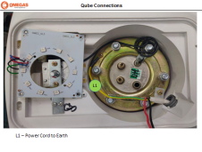
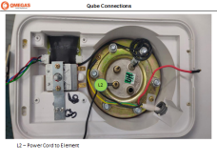
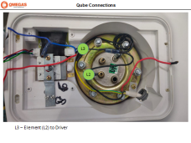
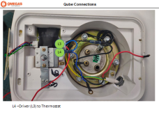
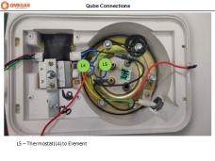
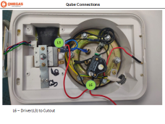
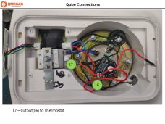
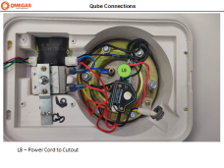
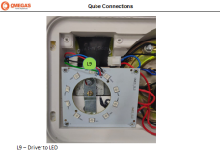
Internal Working of Loose Connection
L1
L2
L3
L4
L5
L6
L7
L8
L9
**All the connection Details shared with Crompton for better understating of particular connection loose

Slide 7
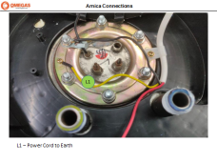
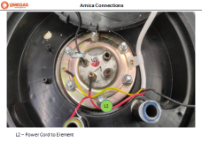
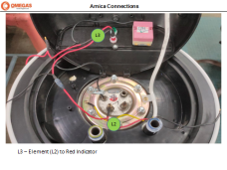
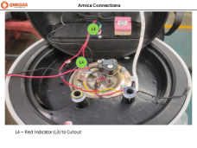
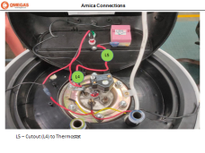
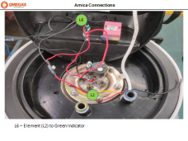
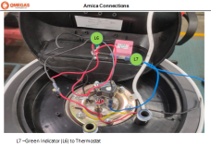
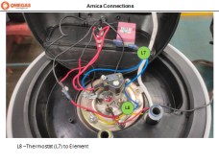
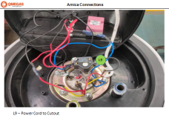
Internal Working of Loose Connection
L1
L2
L3
L4
L5
L6
L7
L8
L9
**All the connection Details shared with Crompton for better understating of particular connection loose

Slide 8
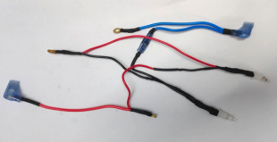
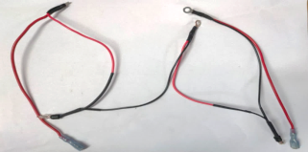
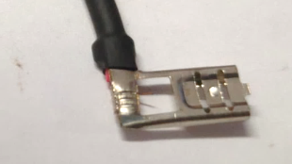
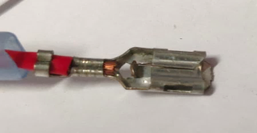
Internal Working of Loose Connection
1- Shorten the connection
Existing Wire harness
Propose Development Wire harness
2- Positive lock
Existing Lock
Propose Lock
* ECR submitted to Crompton waiting for approval

Slide 9
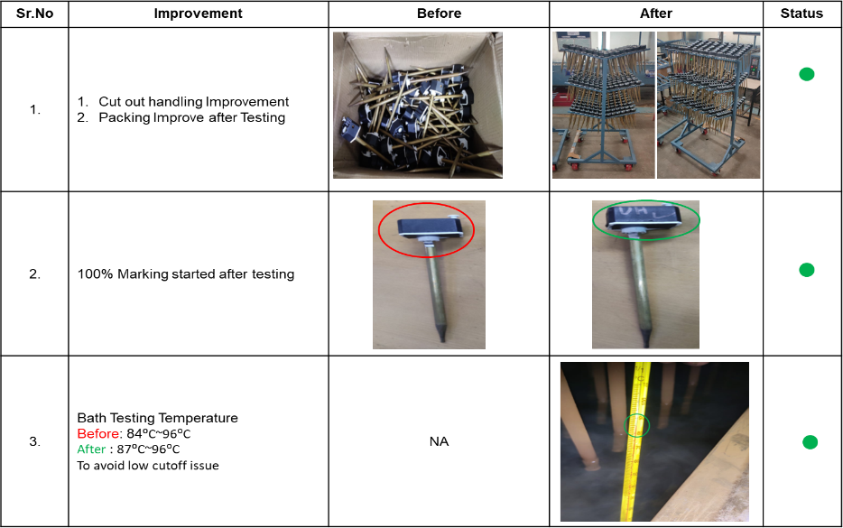
Thermal Cutout Handling & Storage Improvement

Slide 10
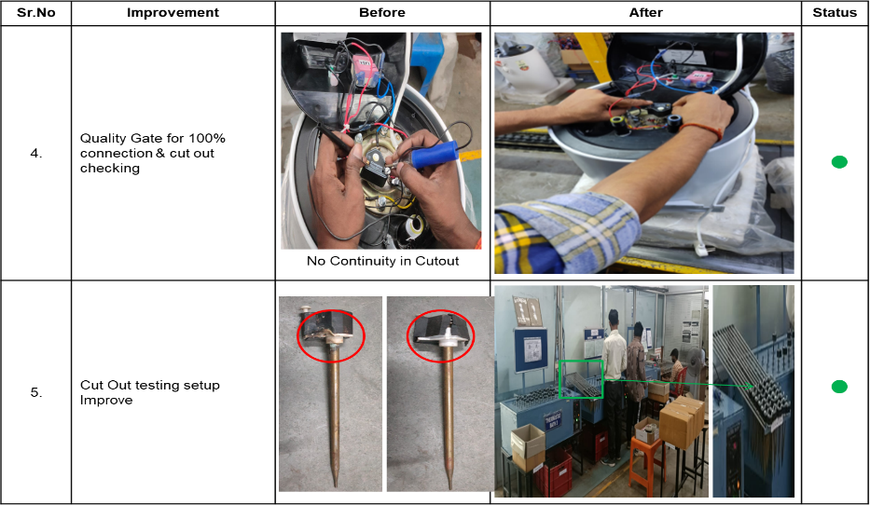
Thermal Cutout Handling & Storage Improvement

Slide 11
Capillary Thermostat on cyclic Test

Slide 12
GRC Analysis Amica
AMICA Reported Complaint With GRC 2021-22
Particular | 2010 | 2015 | 2025 | Total
Dented / Damage | 32 | 32 | 64 | 128
Tank Leakage | 148 | 240 | 193 | 581
Element | 0 | 4 | 1 | 5
Other | 62 | 70 | 61 | 193
Total | 242 | 346 | 319 | 907
AMICA Observed Complaint GRC
Particular | 2010 | 2015 | 2025 | Total
Dented / Damage | 85 | 97 | 122 | 304
Tank Leakage from Pressure Plate | 11 | 28 | 33 | 72
Tank Leakage from Element | 1 | 5 | 1 | 7
Tank Leakage from tank | 42 | 34 | 18 | 94
No Leakage | 76 | 144 | 111 | 331
Other Party Element | 22 | 18 | 29 | 69
Dry Heat Element | 3 | 10 | 2 | 15
Other Party Geyser | 2 | 10 | 0 | 12
Other | 0 | 0 | 3 | 3
Total | 242 | 346 | 319 | 907

Slide 13
GRC Analysis Qube
Qube Reported Complaint With GRC 2021-22
Particular | 2410 | 2415 | 2425 | Total
Dented / Damage | 0 | 52 | 55 | 107
Tank Leakage | 0 | 68 | 45 | 113
Element | 0 | 2 | 0 | 2
Other | 0 | 53 | 34 | 87
Total | 0 | 175 | 134 | 309
Qube Observed Complaint GRC 2021-22
Particular | 2410 | 2415 | 2425 | Total
Dented / Damage | 0 | 104 | 86 | 190
Tank Leakage from Pressure Plate | 0 | 9 | 11 | 20
Tank Leakage from Element | 0 | 1 | 0 | 1
Tank Leakage from tank | 0 | 9 | 5 | 14
No Leakage | 0 | 45 | 27 | 72
Other Party Element | 0 | 2 | 0 | 2
Dry Heat Element | 0 | 3 | 1 | 4
Other Party Geyser | 0 | 0 | 3 | 3
Other | 0 | 2 | 1 | 3
Total | 0 | 175 | 134 | 309

Slide 14
Process Rejection
Body Rejection
Month | Total Qty. Checked | Total OK | Total Rejection | Coating & Fabrication | Transportation Dent | Target% | % Of Rejection
Aug-21 | 18420 | 17351 | 1069 | 453 | 616 | 2 | 5.8
Sep-21 | 15088 | 14400 | 688 | 218 | 470 | 2 | 4.6
Oct-21 | 9507 | 9230 | 277 | 83 | 178 | 2 | 2.9
Nov-21 | 5953 | 5717 | 236 | 110 | 126 | 2 | 4.0

Slide 15
Process Rejection
Coating Rejection
Month | Total Qty. Checked | Total OK | Total Rejection | Coating & Fabrication | Transportation Dent | Target% | % Of Rejection
Aug-21 | 24944 | 24222 | 722 | 6 | 2.9 | Aug-21 | 24944
Sep-21 | 21105 | 20406 | 699 | 6 | 3.3 | Sep-21 | 21105
Oct-21 | 16444 | 15929 | 515 | 6 | 3.1 | Oct-21 | 16444
Nov-21 | 10699 | 10211 | 488 | 6 | 4.6 | Nov-21 | 10699

Slide 16
Process Rejection
Tank Leakage before Coating
Month | Total Qty. Checked | Total OK | Total Rejection | Target % | % Of Rejection
Aug-21 | 24783 | 24576 | 207 | 3 | 0.84
Sep-21 | 23027 | 22642 | 385 | 3 | 1.67
Oct-21 | 15989 | 15656 | 333 | 3 | 2.08
Nov-21 | 11151 | 11040 | 111 | 3 | 1.00

Slide 17
Process Rejection
Tank Leakage after Coating
Month | Total Qty. Checked | Total OK | Total Rejection | Element | Thermostat & cutout pocket | Tank | Target % | % Of Rejection
Aug-21 | 25357 | 25195 | 162 | 6 | 155 | 1 | 0.2 | 0.6
Sep-21 | 21955 | 21691 | 264 | 4 | 253 | 7 | 0.2 | 1.2
Oct-21 | 15895 | 15646 | 249 | 0 | 249 | 0 | 0.2 | 1.6
Nov-21 | 10283 | 10086 | 197 | 7 | 190 | 0 | 0.2 | 1.9
1.9

Slide 18
Process Rejection
AMICA Final Testing Rejection
November-2021
Final Testing Amica
Particular | Qty Checked | Qty Rejected | Target % | % Rejection
Safety | 5981 | 49 | 0.5 | 0.8
Functional | 5981 | 136 | 1 | 2.3
Aesthetic | 5981 | 29 | 1 | 0.5
QUBE Final Testing Rejection
Final Testing Qube
Particular | Qty Checked | Qty Rejected | Target % | % Rejection
Safety | 3773 | 9 | 0.5 | 0.2
Functional | 3773 | 12 | 1 | 0.3
Aesthetic | 3773 | 90 | 1 | 2.4

Slide 19
PDI Index FY 21-22
Month | Model Wise Lot inspected |  |  |  | Total Lot Inspected | No of Lot Rejected |  |  |  | Total Lot Rejected | Lot Accepted | Lot Rejection% | Reason of Rejection
 | Qube |  | Amica |  |  | Qube |  | Amica
 | Internal | External | Internal | External |  | Internal | External | Internal | External |  |  |  | SAFETY | FUNCTIONAL | AESTHETICS
Aug-21 | 24 | 24 | 18 | 25 | 91 | 0 | 1 | 0 | 2 | 3 | 88 | 3.3 | 0 | 0 | 3
Sep-21 | 15 | 24 | 20 | 12 | 71 | 2 | 5 | 0 | 1 | 8 | 63 | 11.3 | 0 | 0 | 3
Oct-21 | 18 | 11 | 14 | 13 | 56 | 0 | 0 | 1 | 2 | 3 | 53 | 5.4 | 0 | 0 | 3
Nov-21 | 11 | 6 | 15 | 3 | 35 | 0 | 2 | 0 | 0 | 1 | 34 | 2.9 | 0 | 0 | 2

Slide 20
Rejection against Target

Slide 21


Material Supplier Rating
S. NO. | TOP SUPPLIER | TOTAL | OK | NG | ACCEPT %AGE
1 | Onkar D-255 | 67 | 67 | 0 | 100
2 | Onkar E-14 | 29 | 29 | 0 | 100
3 | Foam Pack India Pvt. Ltd. | 29 | 29 | 0 | 100
4 | Durga Industries D-38 | 26 | 26 | 0 | 100
5 | Cliffton Packaging | 18 | 18 | 0 | 100

Slide 22
Material Supplier Rating
S. No. | WORST SUPPLIER | TOTAL | OK | NG | ACCEPT %AGE
1 | Prasad Electrical | 10 | 7 | 3 | 70%
2 | Garg Enterprises | 11 | 10 | 1 | 91%
3 | Animesh | 13 | 12 | 1 | 92%
4 | General Electricals | 41 | 38 | 3 | 93%

Slide 23
No. of Kaizen’s of FY 2018-19, 2019-20 & 2020-21
Due to covid Qty less as compare to last year 2019-20

Slide 24
Kaizen of Novemeber’21
Onkar Engine & Generator (P) Limited
Kaizen Index (2021-22)
S.No | Kaizen Title | Month of Implementation | Area of Implementation
1 | No location for PCB inspection | November'21 | IQC
2 | No location Puf Short Controller |  | Assembly
3 | Puf pouring hose pipe setup |  | Assembly
4 | Plastic Bag used to kept rejection material |  | Molding

Slide 25
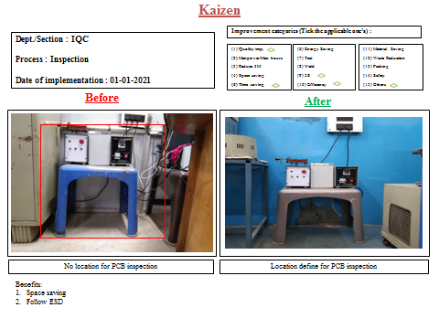
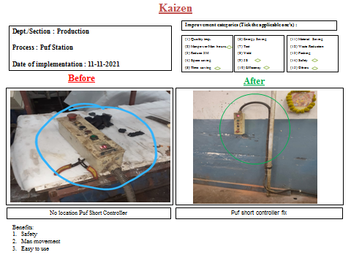
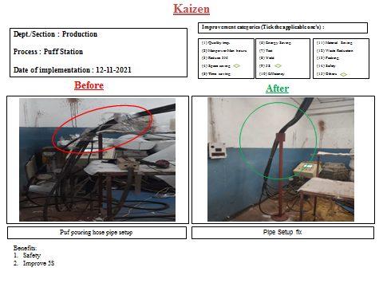
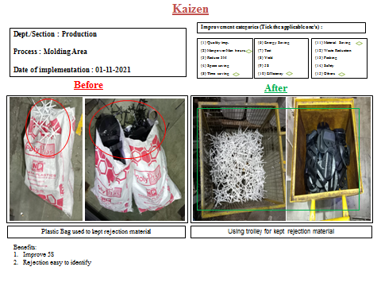
Kaizen of Novemeber’21

Slide 26
ECR
Wire Harness
Jacket

Slide 27
Thanks

